Slide 1
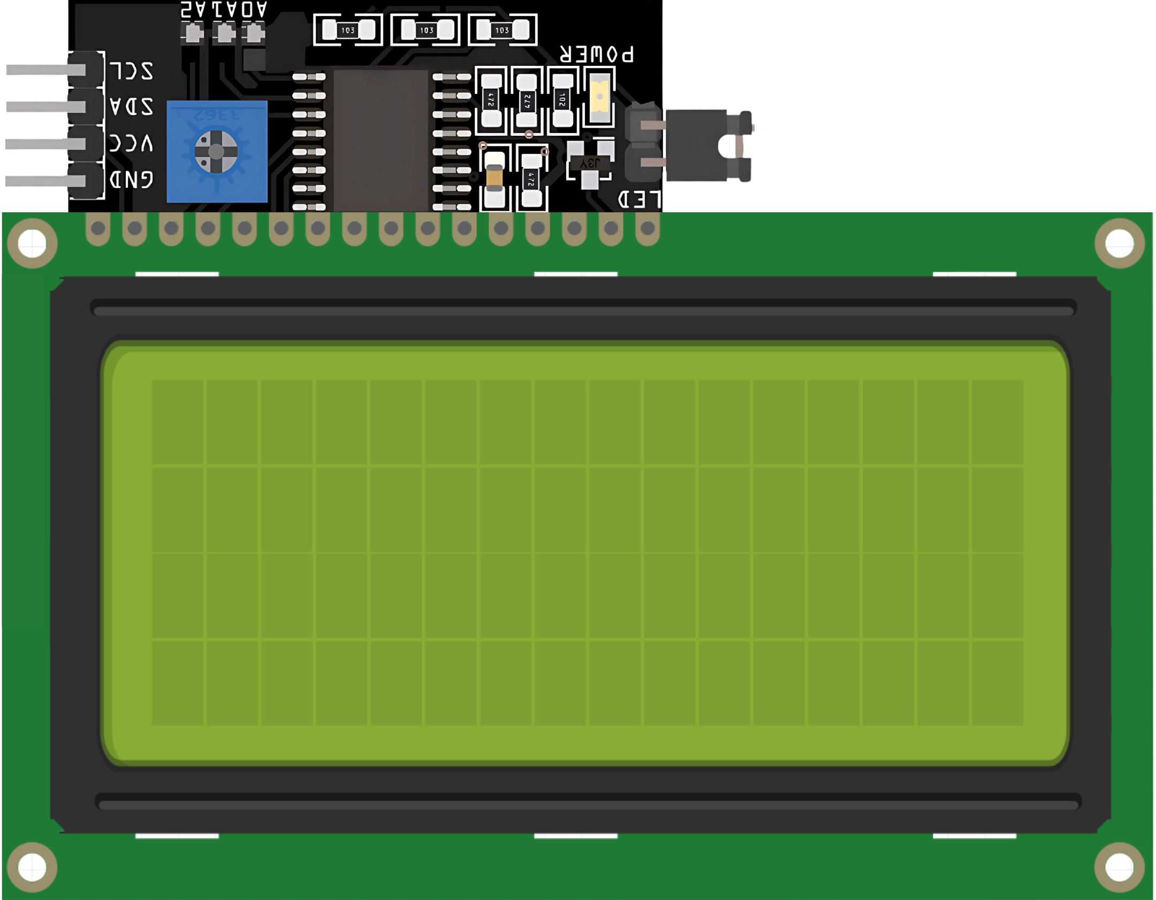
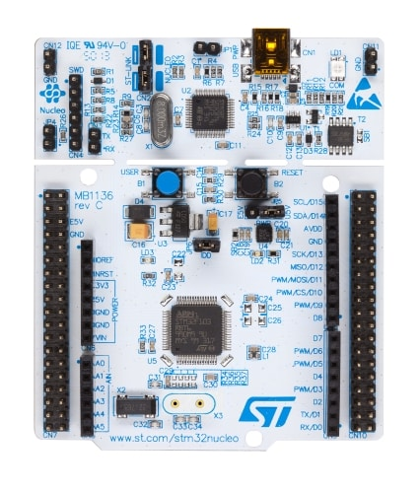
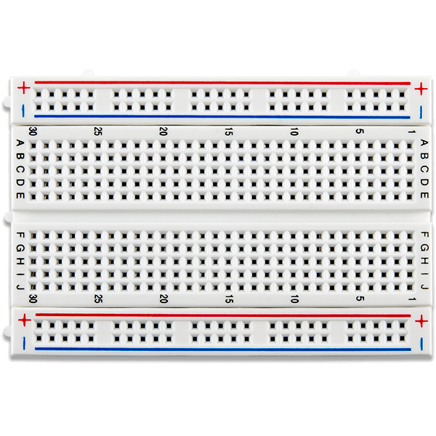
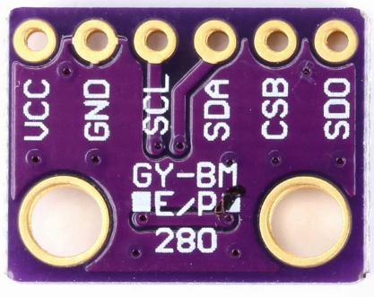
Weather Monitoring System
Temperature : 35.75 C
Pressure : 1004.7 hPa
20*4 LCD Display with I2C Module
BMP280 Sensor
STM32 Nucleo-F446RE Board
Fig 01: Circuit Diagram of an Environmental Monitoring System using STM32 and BMP280.

